Slide 1


A. Enes GURSOY
27th April 2022

Slide 2

Outline
Executive Summary
Introduction
Methodology
Results
Conclusion
Appendix

Slide 3
Executive Summary
Summary of methodologies
In this project, we used several methodologies for each data analysis and modelling sections. Firstly, collected data with an API. After that, used BeautifulSoup for Web Scraping. For data wrangling, we used pandas and numpy python libraries. Then, analyzed data with SQL and data visualization. Folium was the interactive visualization tool we used for visual analytics.In the end, we created a model for predictive analysis.

Slide 4
Executive Summary
Summary of all results
After all work is done, we learned so much from the data. Those are:
Launch success rate have an increase trend after 2013.
Larger flight amount at a launch site, means greater success rate at a launch site.
Orbits ES-L1, GEO, HEO, SSO, VLEO has the most success rate.
KSC LC-39A (Kennedy Space Center Launch Site) has the most successful launches.
Decision tree classifier could be used for predictive analysis in this dataset.

Slide 5
Introduction
SpaceX is one of the most company in nowadays. In this project we will examine how successful SpaceX about sending Falcon 9 rockets out of the sky. In SpaceX’s website, they define Falcon 9 rockets as ‘’Falcon 9 is the world’s first orbital class reusable rocket. Reusability allows SpaceX to refly the most expensive parts of the rocket, which in turn drives down the cost of space access.’’. So, most important factor of Falcon 9’s success is reusability. We’ll try to understand this reusability and finding parameters about this situation.
Problems we want to find answers:
Which parameters effect landing succession ?
Are there any links between different parameters ?
Can we predict outcomes with machine learning in this dataset ?

Slide 6

Section 1

Slide 7
Methodology
Executive Summary
Data collection methodology:
In this project, we used SpaceX API and web scraping tool BeatifulSoup for gathering data from Wikipedia.
Perform data wrangling
We wrangled data with one-hot encoding method with pandas/numpy libraries.
Perform exploratory data analysis (EDA) using visualization and SQL
In the EDA section of the project, we used some visualization tools and SQL queries.

Slide 8
Methodology
Executive Summary
Perform interactive visual analytics using Folium and Plotly Dash
After EDA we analyze the data with Folium map visualization tool and Ploty Dash
Perform predictive analysis using classification models
Lastly, we created a predictive analyzing model using several classifiers such as decision tree, K Neighbors etc.

Slide 9
Data Collection
In this project data collected with using several methods. This methods are :
First, we performed an HTTP GET method to request the Falcon9 Launch HTML page, as an HTTP response.
Created a BeautifulSoup object from the HTML response
Next, we collected all relevant column names from the HTML table header
Then, we used extract_column_from_header() function to extract column name one by one
Created an empty dictionary with keys from the extracted column names
Filled in the parsed launch record values into launch_dict
Created a dataframe from ‘’launch_dict’’ dictionary
You need to present your data collection process use key phrases and flowcharts

Slide 10
Data Collection – SpaceX API
Define a variable includes website link
Use requests.get() method with this variable for get HTTP response
Used HTTP GET method to request Falcon9 Launch.
Link to the notebook:
Data Collection Notebook

Slide 11
Data Collection - Scraping
Created object from response text with BeautifulSoup
Used find_all() function for ‘table’ type elements
Used extract_column_from_header() function for column names
Created a dictionary by parsing the HTML tables
Converted dictionary to dataframe
After getting HTTP response we scraped this data to more readable source.
Link to the notebook:
Web Scraping Notebook

Slide 12
Data Wrangling
Calculated missing values in each attribute with isnull() function
Identified data types of columns with ‘dtypes’ function
Calculated number of launches on each site and orbit numbers with value_counts() function
Created a landing outcome label from «Outcome» column
After collected data and convert this data to a dataframe we wrangled data for reading data better. We used several methods for data wrangling. Such as value_counts() function and numpy/pandas libraries.
Link to the notebook:
Data Wrangling Notebook

Slide 13
EDA with Data Visualization
In this part, we explored data by analyzing the relationship between flight number and launch Site, payload and launch site, success rate of each orbit type, flight number and orbit type, the launch success yearly trend with data visualization.
Link to the notebook for codes :
EDA w/ Data Visualization

Slide 14
EDA with SQL
Firstly, we loaded database to IBM DB2 database system.
Then, we used SQL queries for data analysis. Such as;
Names of the unique launch sites
5 records where launch sites begin with the string 'CCA‘
Total payload mass carried by boosters launched by NASA (CRS)
Average payload mass carried by booster version F9 v1.1
List the total number of successful and failure mission outcomes etc.
Link to relevant notebook:
EDA with SQL Notebook

Slide 15
Build an Interactive Map with Folium
Summarize what map objects such as markers, circles, lines, etc. you created and added to a folium map
In this part, we added markers, circles, lines to the folium map. Markers are text objects for defining location. Circles are using for looking area. And lines are simple line for obtaining distance information.
We added this objects for understanding relevancy between some locational properties and landing outcomes.
Link to the notebook is:
Folium Notebook

Slide 16
Build a Dashboard with Plotly Dash
We created a dashboard with Plotly Dash in this part. Added launch site selection dropdown list, pie chart of successful launches count for all sites, slider to select payload range, scatter chart to show correlation between payload and launch success.
This dashboard helped us to understand how launch site and payload effect launch succession.
Link to the notebook:
Dashboard Notebook

Slide 17
Predictive Analysis (Classification)
Created a NumPy array from the column Class in data, by applying the method to_numpy()
Standardize the data using StandartScaler() function
Splitted data to train and test data
Built models for different methods with finding best parameters for each method
Compared models with accuracies
In predictive analysis section we built different machine learning models and tune different hyperparameters using GridSearchCV.
Link to the notebook:
Predictive Analysis Notebook

Slide 18
Results
In Section 1 we analysed data with several methods.
Interactive analytics demo in screenshots
Predictive analysis results

Slide 19

Section 2

Slide 20
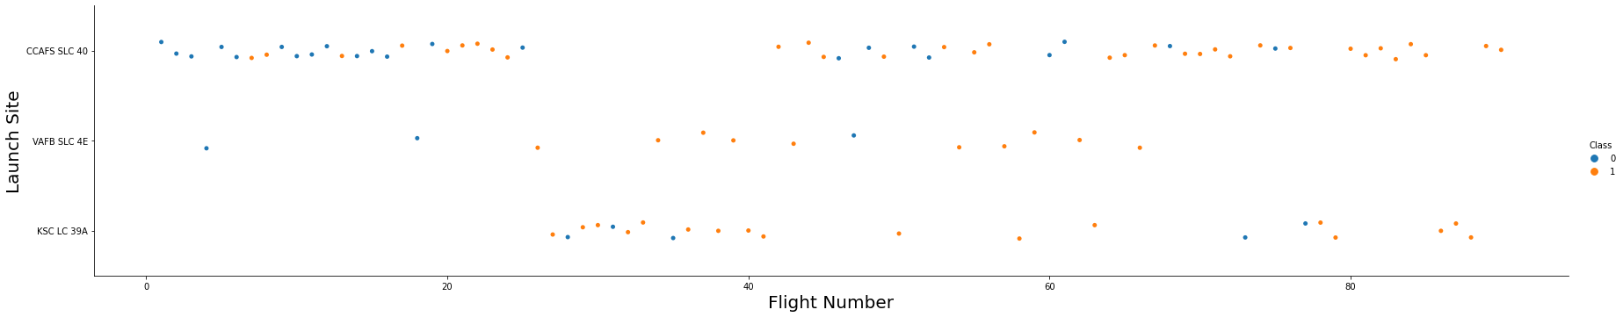
Flight Number vs. Launch Site
As we can see, KSC LC 39-A site has most success rate. And CCAFS has most successful launch counts.

Slide 21
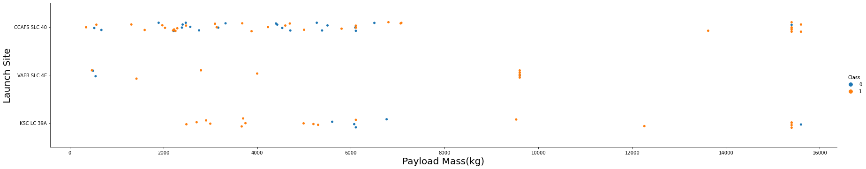
Payload vs. Launch Site
In this chart we can see, with payload mass increasing total number of flights is decreasing. VFB SLC launch site didn’t launch high weighted rocket.

Slide 22
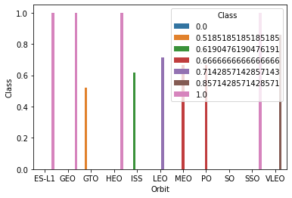
Success Rate vs. Orbit Type
In this figure we can see ES-L1, GEO, HEO, SSO orbits has %100 success rate.

Slide 23
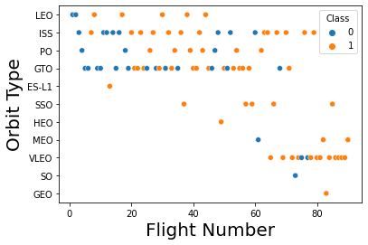
Flight Number vs. Orbit Type
Last slide we saw a bar chart about success rate. In this figure we can see some of the most successful orbits about launch rates are have only 1 launchs. So it’s not true to say those launch sites are most succesfful about launching.

Slide 24
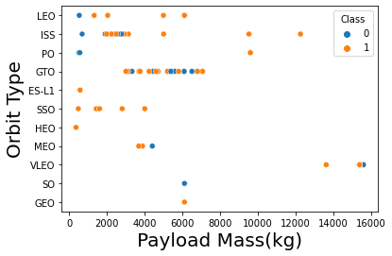
Payload vs. Orbit Type
We can see payload mass with orbit types in this figure.

Slide 25
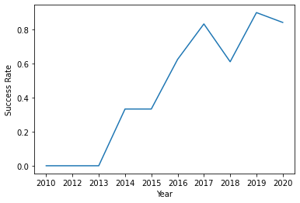
Launch Success Yearly Trend
Launch success rate has increase trend after 2013

Slide 26
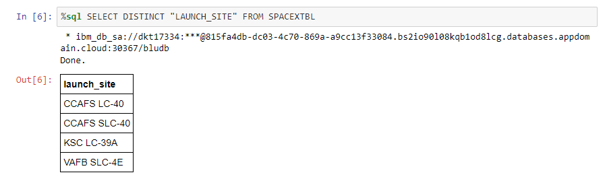
All Launch Site Names
We found each unique launch site name with using ‘’SELECT DISTINCT’’ method.

Slide 27
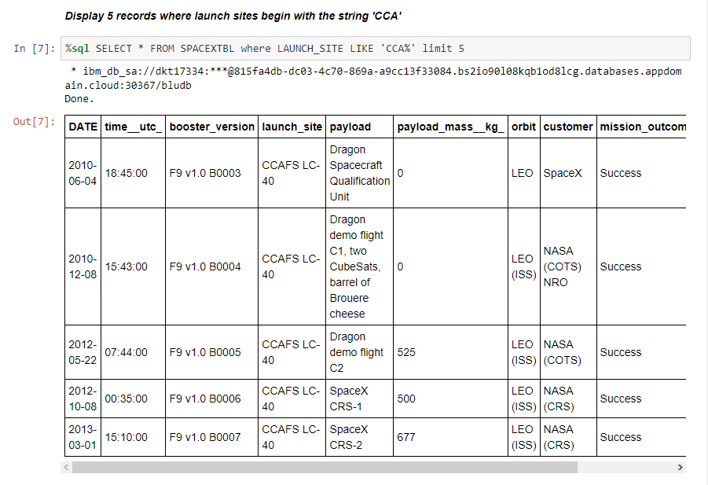
Launch Site Names Begin with 'CCA'
Queried data for launch sites with ‘CCA’ on its first three letter.

Slide 28
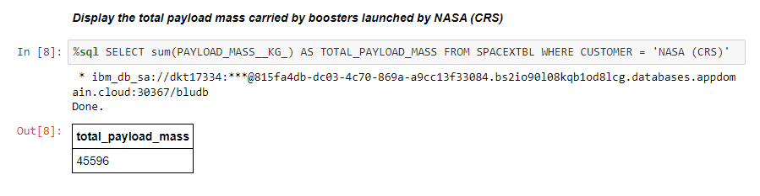
Total Payload Mass
Found total payload mass with ‘’sum’’ method.

Slide 29
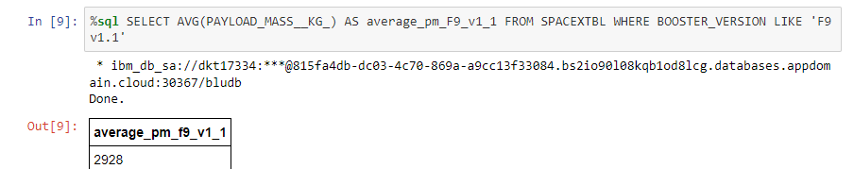
Average Payload Mass by F9 v1.1
Calculated the average payload mass carried by booster version F9 v1.1 with ‘’AVG’’ method.

Slide 30
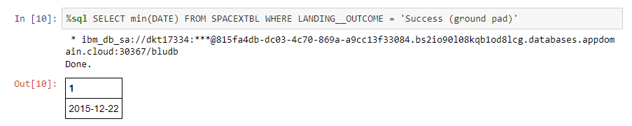
First Successful Ground Landing Date
Found the dates of the first successful landing outcome on ground pad with ‘’min’’ method.

Slide 31
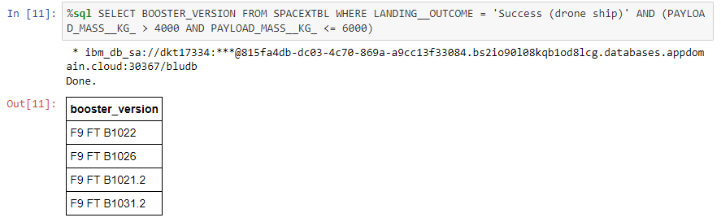
Successful Drone Ship Landing with Payload between 4000 and 6000
Listed the names of boosters which have successfully landed on drone ship and had payload mass greater than 4000 but less than 6000

Slide 32
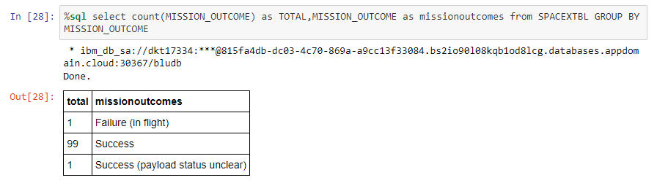
Total Number of Successful and Failure Mission Outcomes
Calculated the total number of successful and failure mission outcomes with ‘’count’’ method.

Slide 33
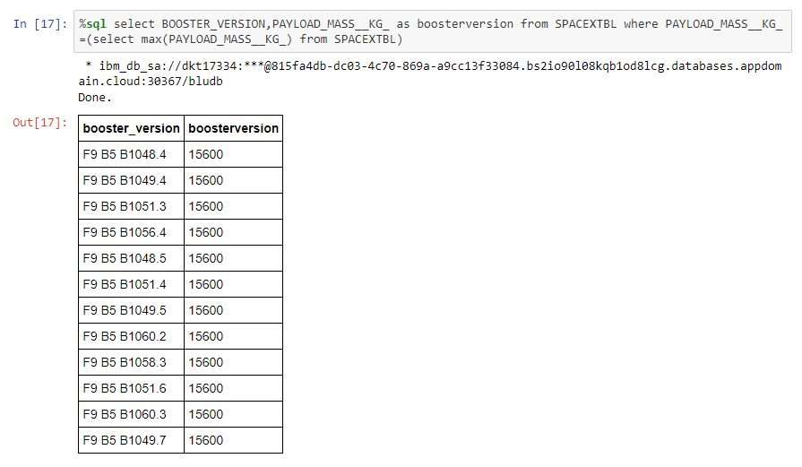
Boosters Carried Maximum Payload
Listed the names of the booster which have carried the maximum payload mass.

Slide 34
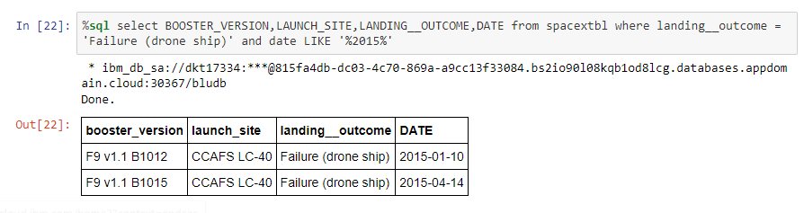
2015 Launch Records
Listed the failed landing outcomes in drone ship, their booster versions, and launch site names for in year 2015

Slide 35
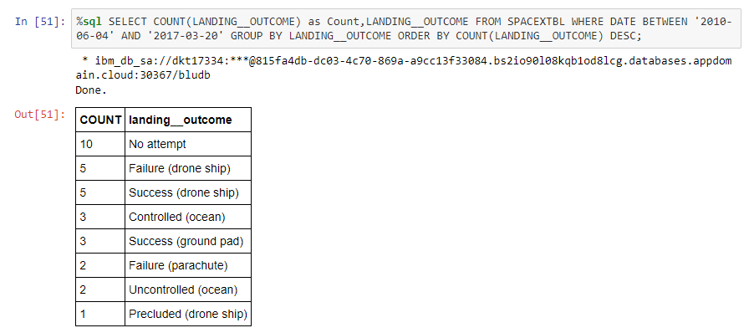
Rank Landing Outcomes Between 2010-06-04 and 2017-03-20
Ranked the count of landing outcomes (such as Failure (drone ship) or Success (ground pad)) between the date 2010-06-04 and 2017-03-20, in descending order

Slide 36

Section 3

Slide 37
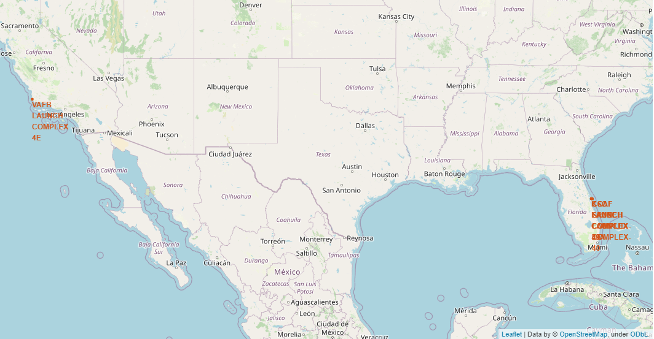
Location Markers
We can see launch site locations on map

Slide 38
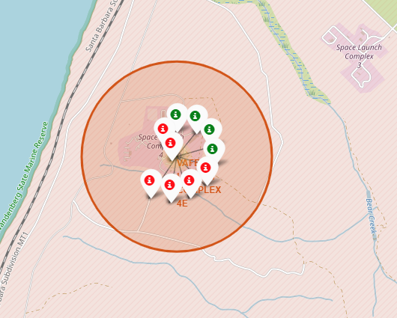
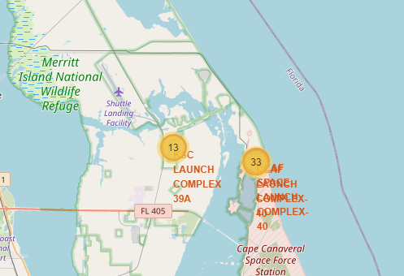
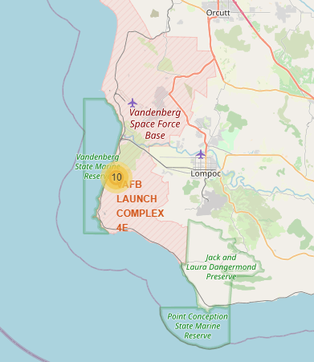
Launch Outcomes
This two figures below shows how much rocket launchs in different launch sites
We can see failed and successed launch mission in VAFB launch complex above.

Slide 39
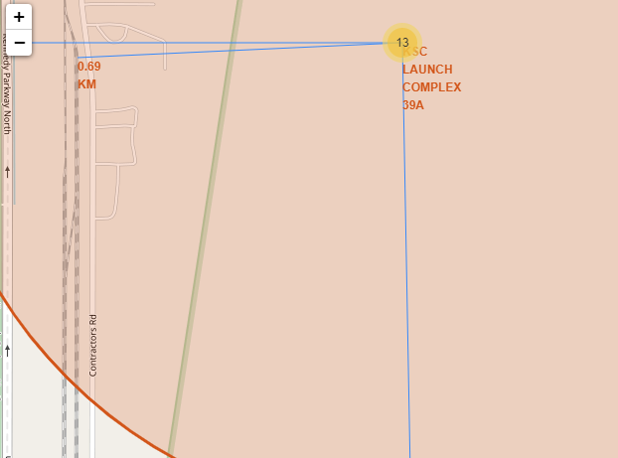
Distance to Important Places
We created lines for Kennedy Space Center Launch Complex. Used those lines for calculating distance from closest coastline,railway,city center and highway.

Slide 40

Section 4

Slide 41
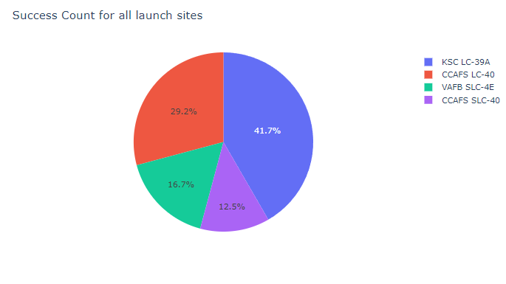
Success Rate for Launch Sites
Total success counts for all launch sites can be seen on the right. Kennedy Space Center Launch Complex has most successful launchs as we can see.

Slide 42
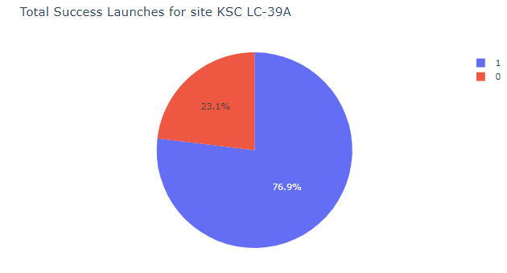
Highest Success Ratio Launch Site
Kennedy Space Center Launch Complex also has highest succest ratio compare to others.

Slide 43
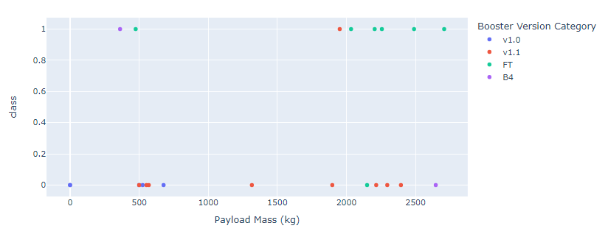
Launch outcomes with low weight payloads
(0-3000kg) and different boosters

Slide 44
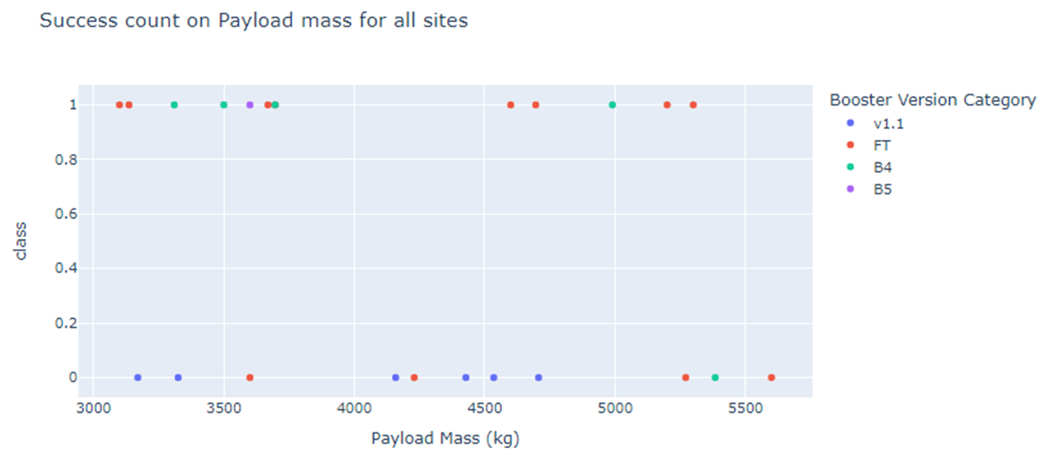
Launch outcomes with medium weight payloads
(3000-6000 kg) and different boosters

Slide 45
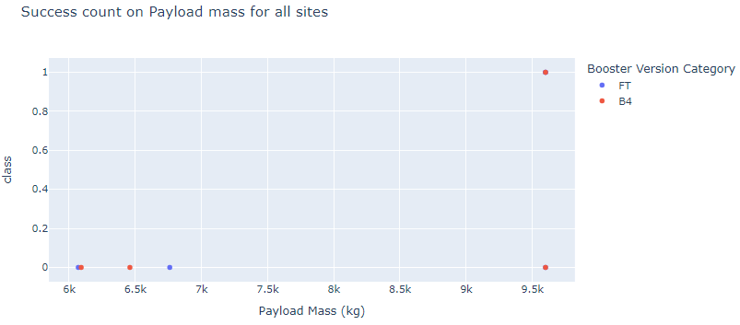
Launch outcomes with high weight payloads
(6000-10000 kg) and different boosters
So, with all of this charts we can see success rates for high weight payloads are lower than medium and low weight payloads. And FT labeled boosters are more successful with low and medium weight payloads.

Slide 46

Section 5

Slide 47
Classification Accuracy
As we can see, all models have same accuracy. So we can use each of those.

Slide 48
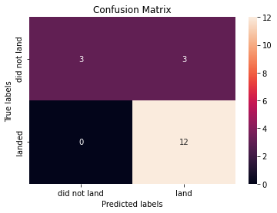
Confusion Matrix
There’s confusion matrix of Decision Tree Classifier:
We see that decision tree classifier can distinguish between two different classes. We see that the major problem is false positives.

Slide 49
Conclusions
Launch success rate have an increase trend after 2013.
Larger flight amount at a launch site, means greater success rate at a launch site.
Orbits ES-L1, GEO, HEO, SSO, VLEO has the most success rate. But some of those orbits(ES-L1, GEO, HEO) has only 1 launch. So this information not healthy about all orbits.
KSC LC-39A (Kennedy Space Center Launch Site) has the most successful launches.
Decision tree classifier could be used for predictive analysis in this dataset.

Slide 50
Appendix
Github Project Link : https://github.com/arty00/IBM_DS_Capstone.git

Slide 51


